Slide 1

MYTH BUSTING: Challenging Traditions to Save More Cats
Erica Roewade
Outreach Director
Liz Houtz
Programs Director
www.catsinaction.org
Chicago

Slide 2

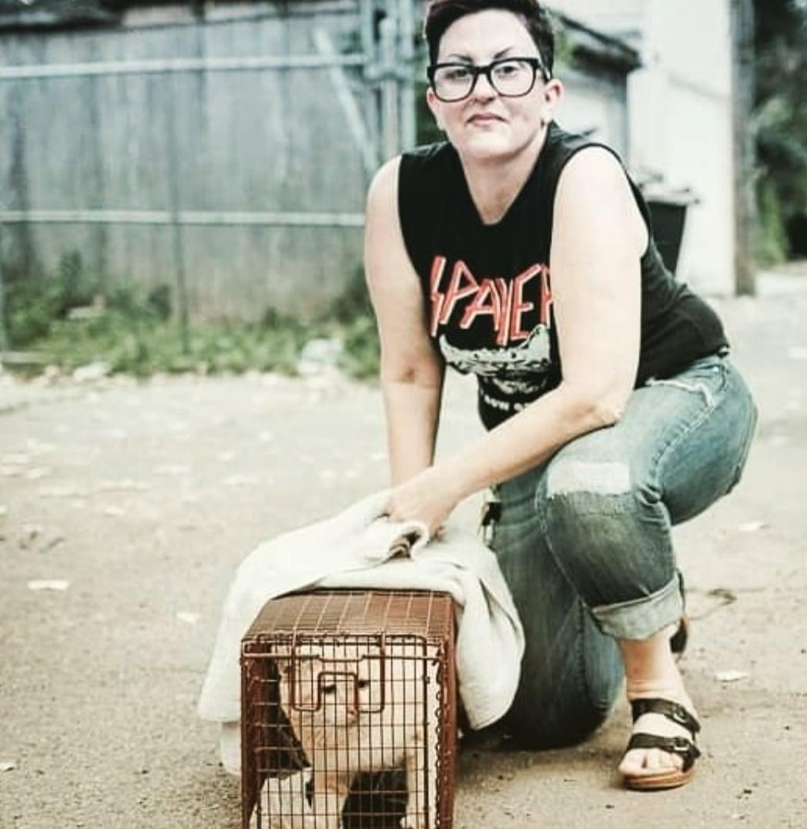
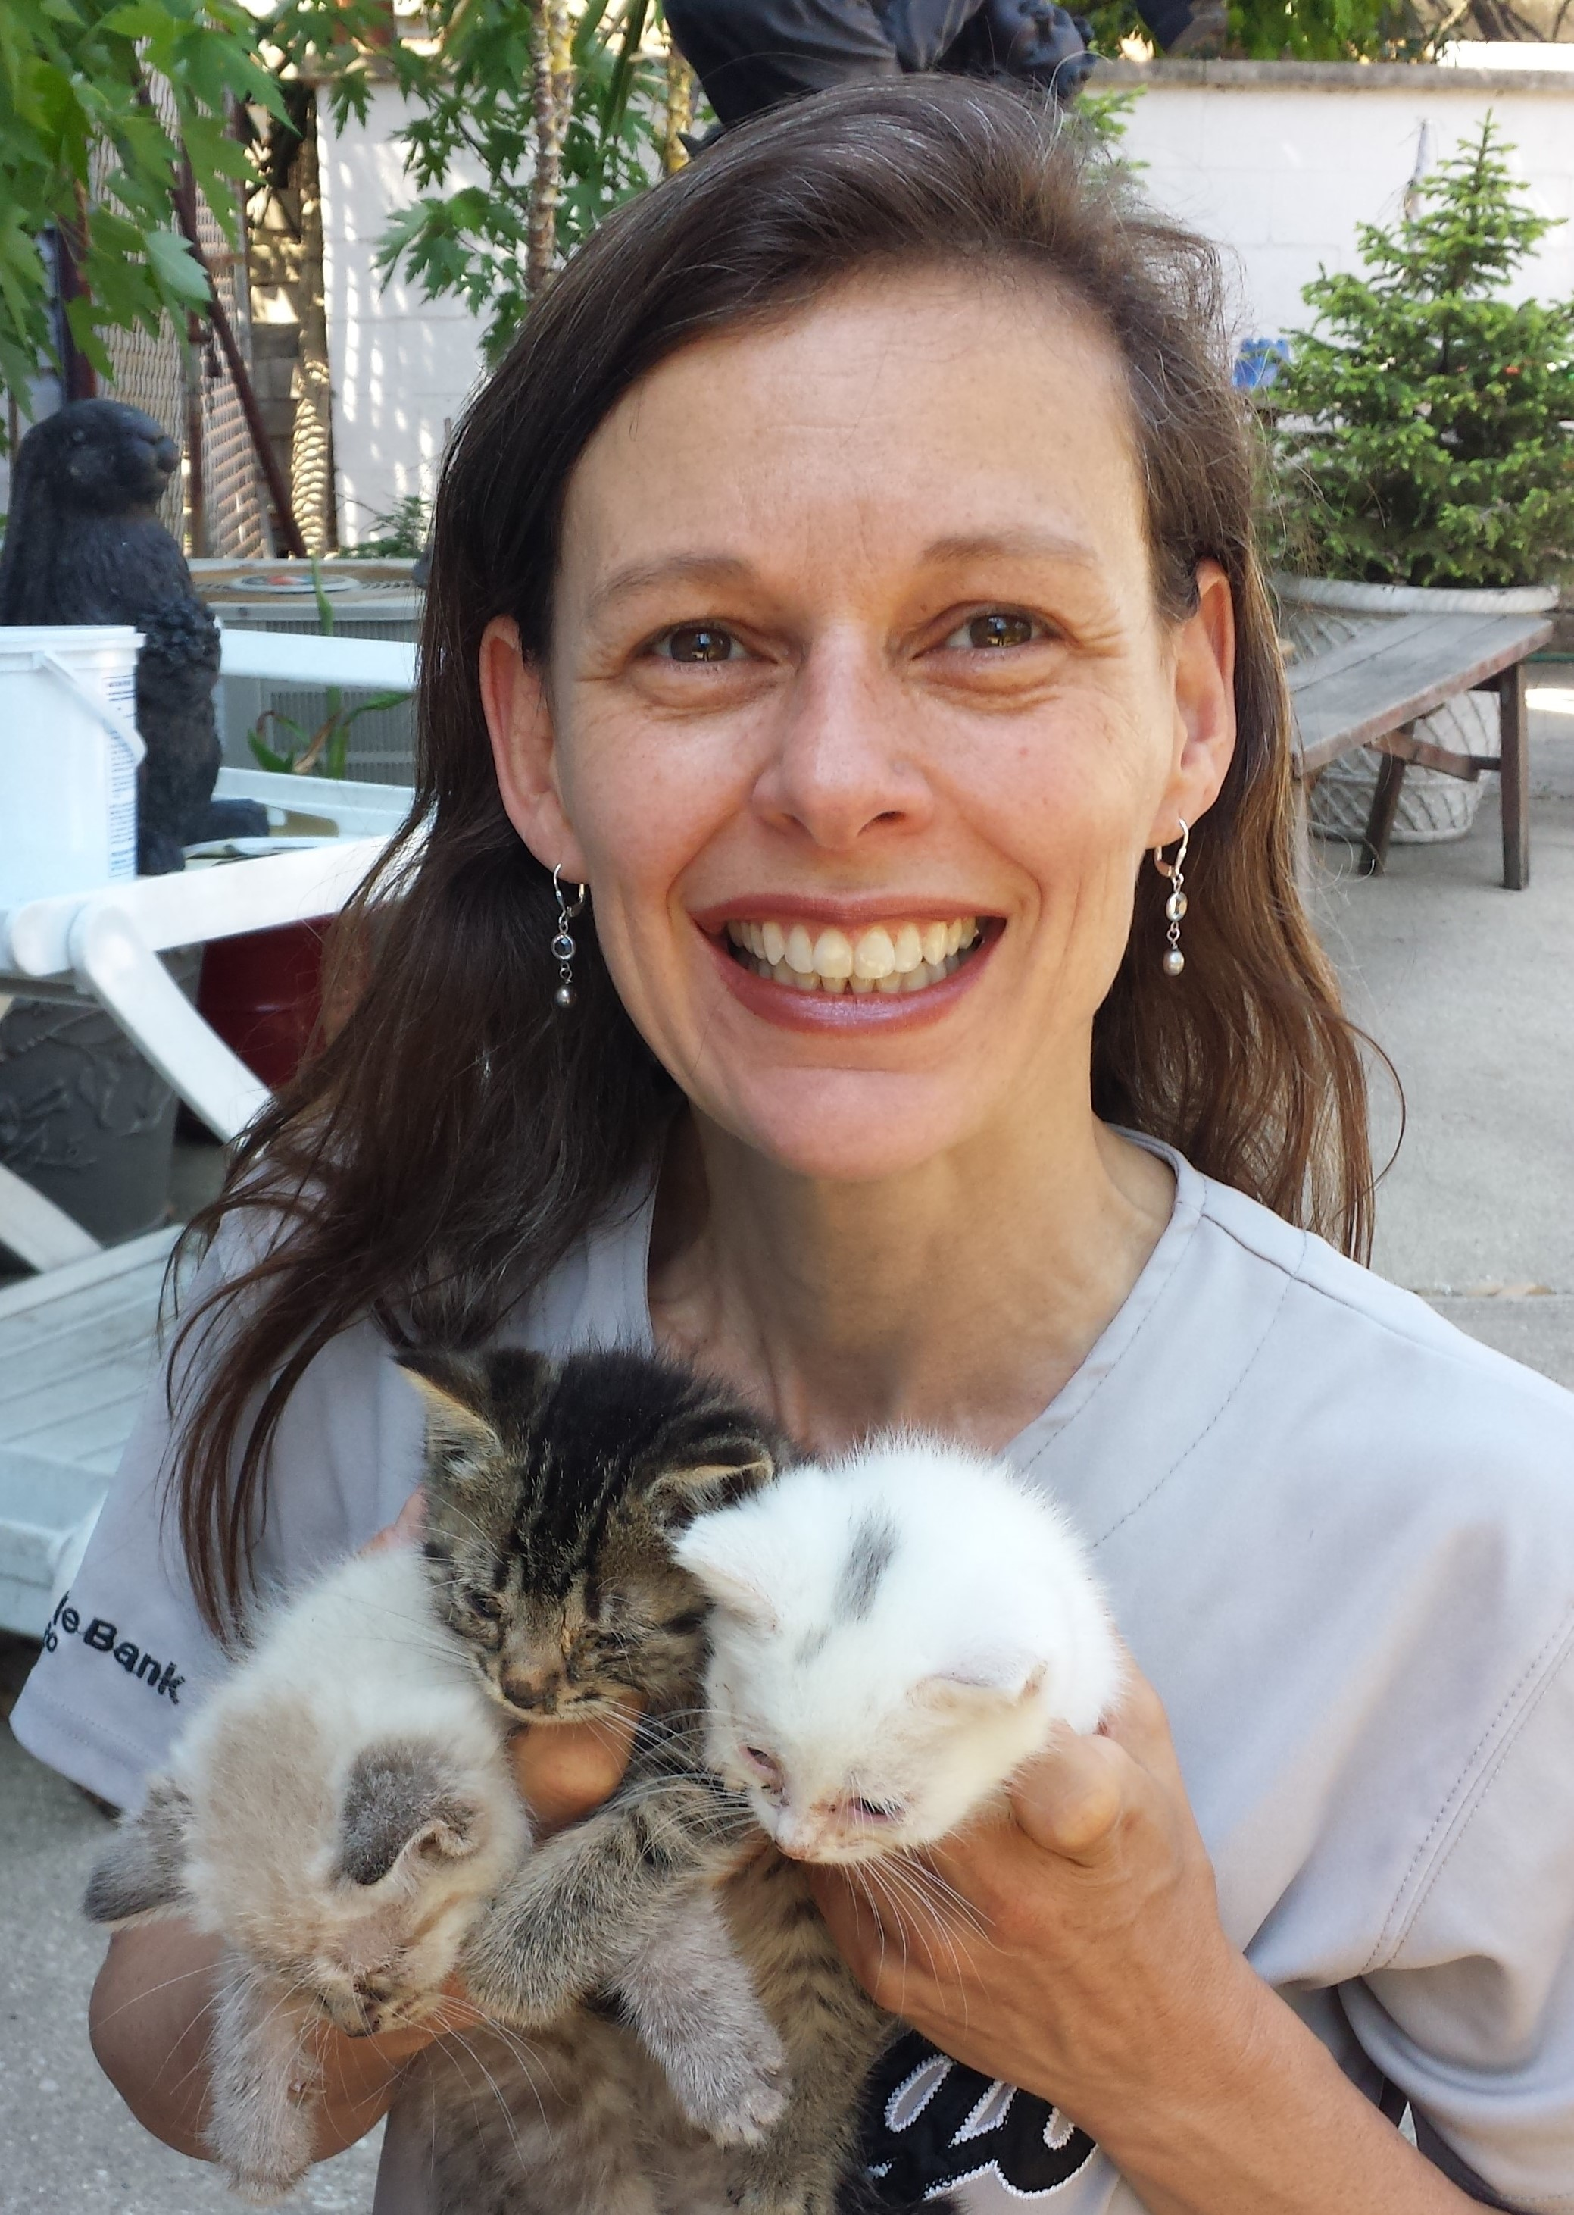

ERICA
Archeology/MA
Community Cats Coordinator at 2 large Chicago shelters 2013-16
LIZ
Engineering/MBA
Community Cats Program Manager at Chicago’s largest cat-only shelter 2013-17
Co-founded Cats in Action 2020 as a TNR resource group
Established non-profit 2022
Combined 25 years of experience
TNR
Dispute management
Intake diversion
Hoarding projects
Working cats
Barn cats

Slide 3
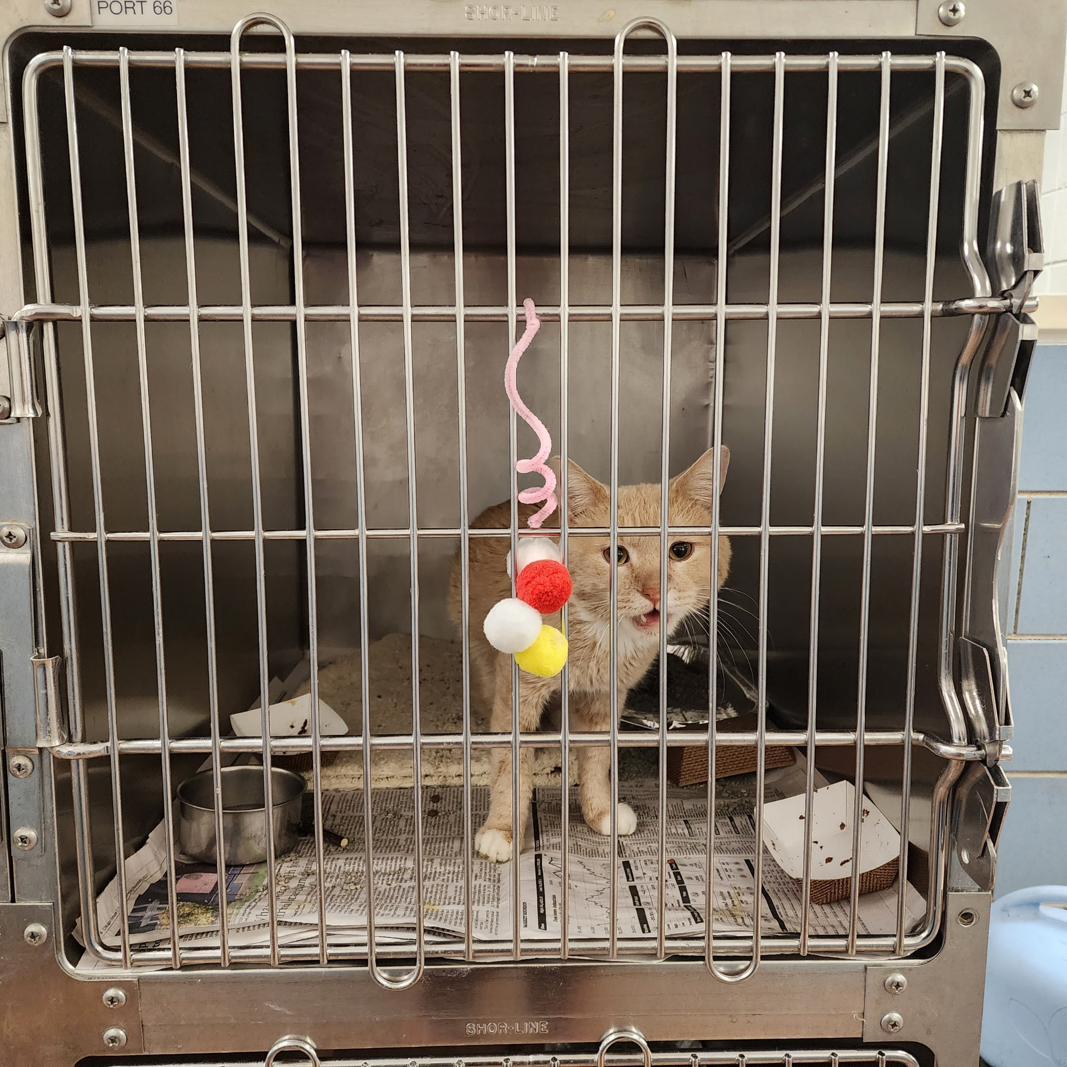
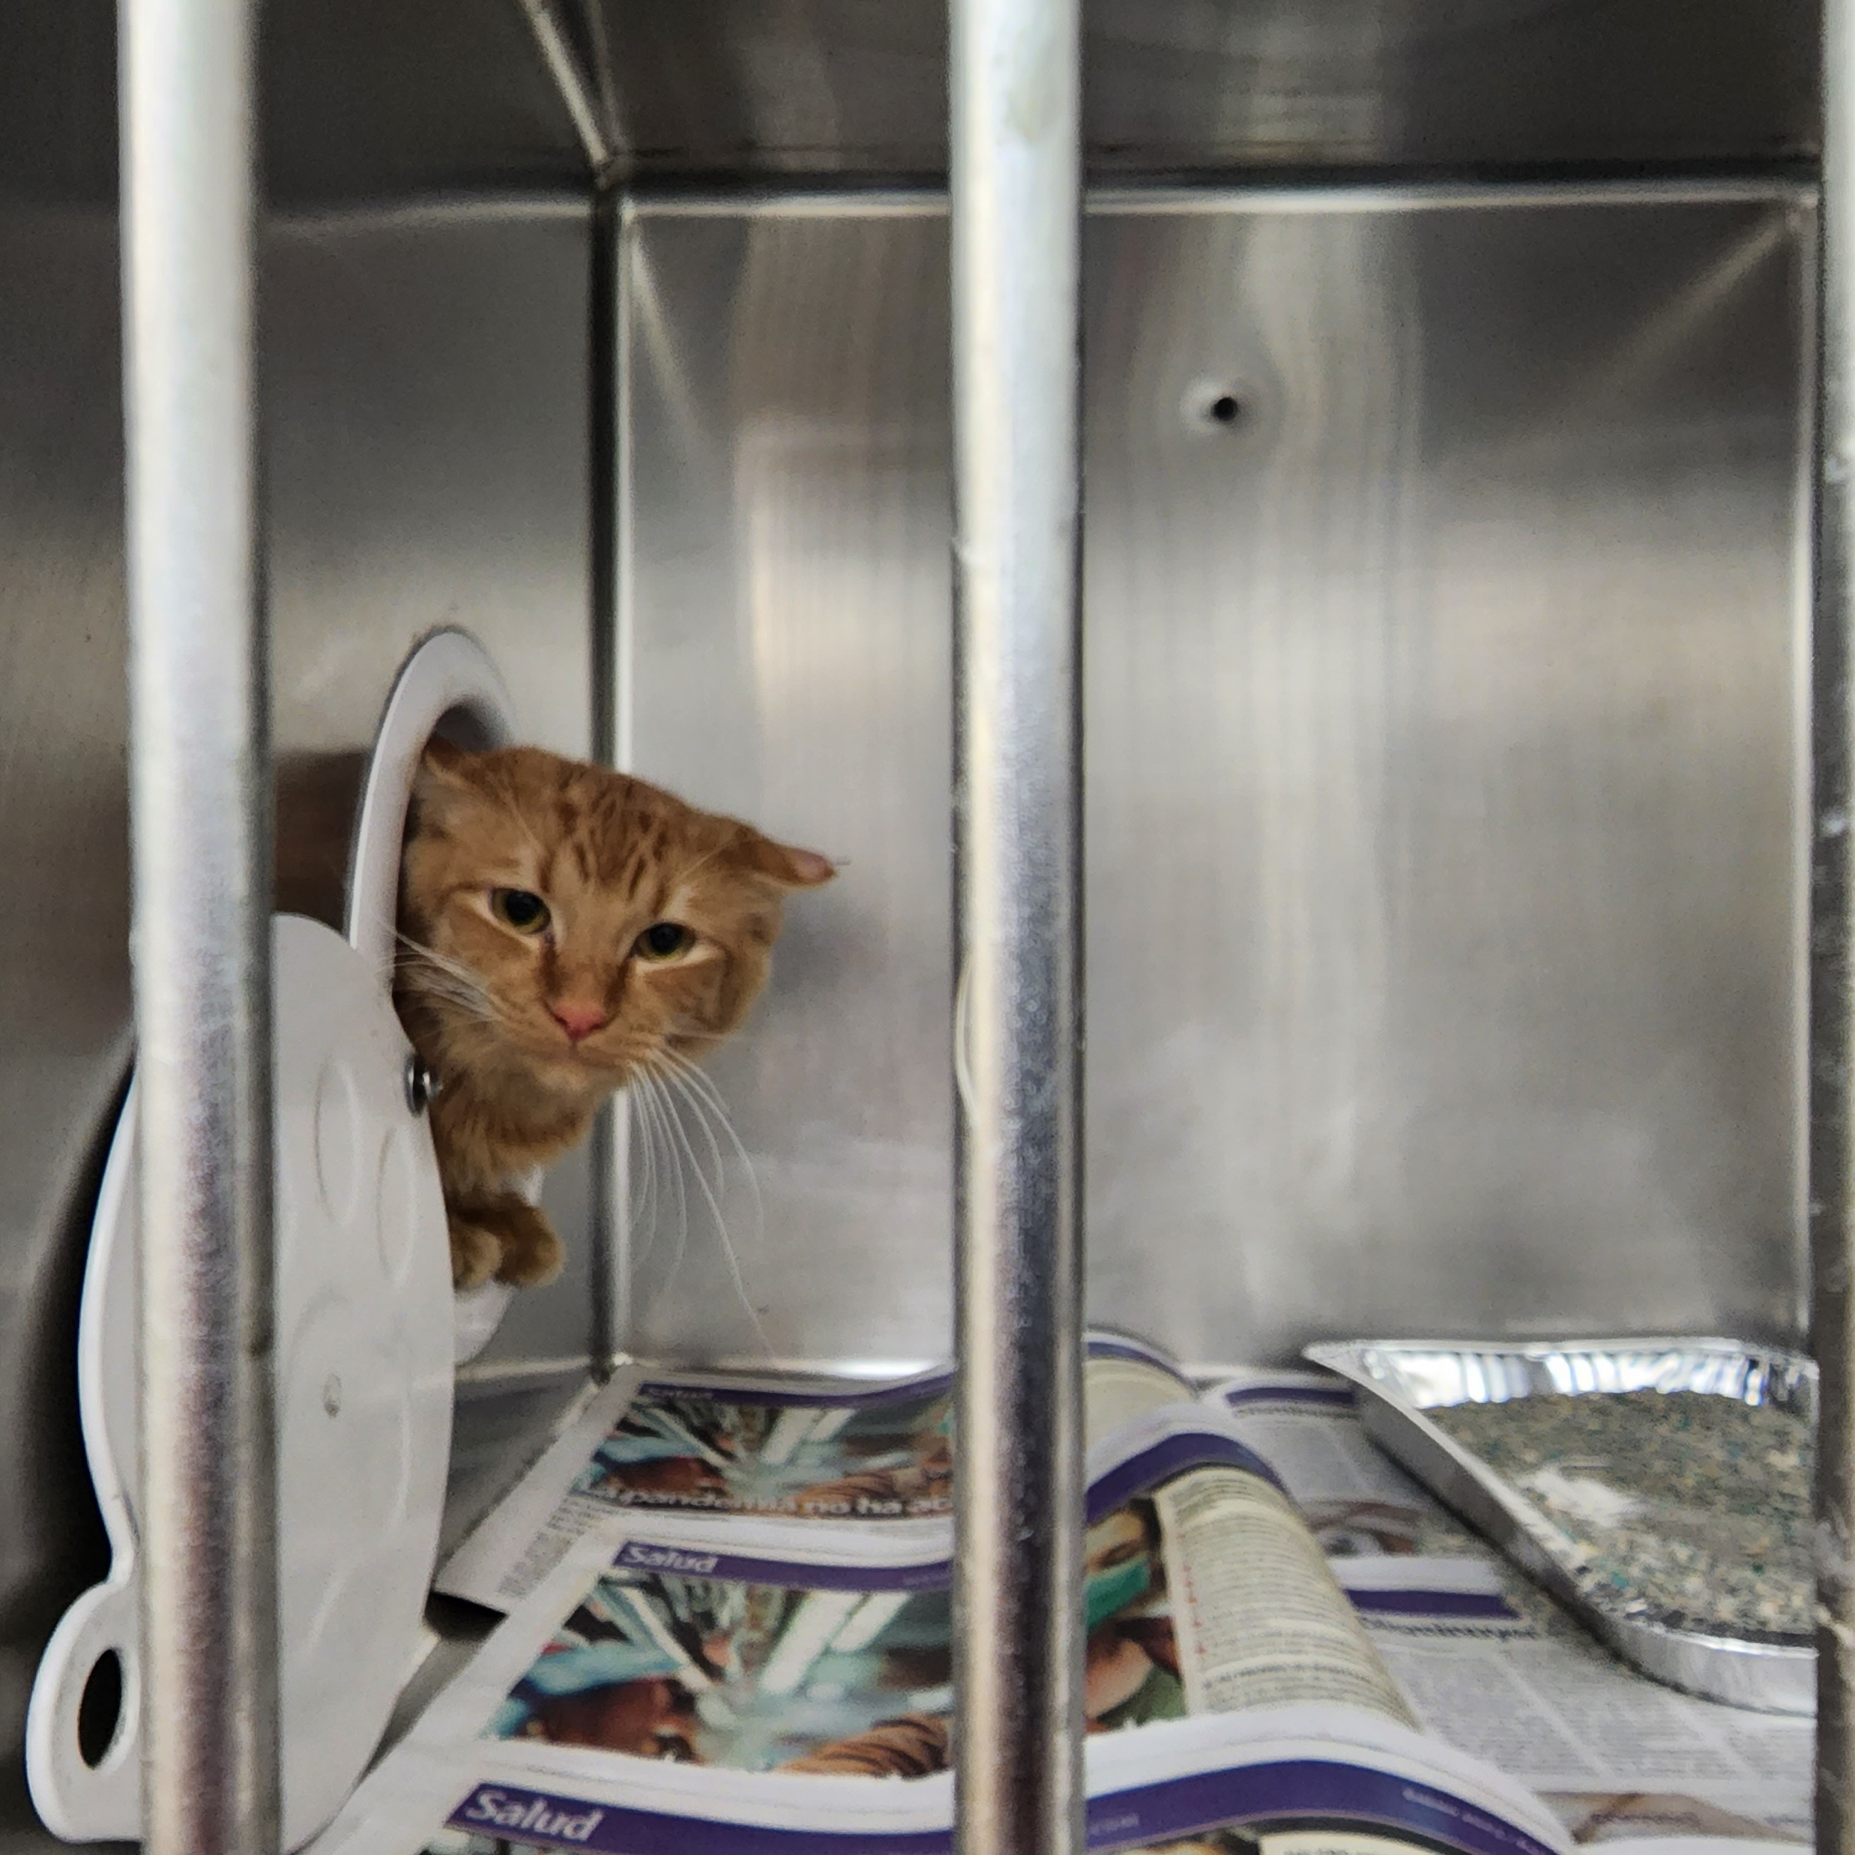
Traditional policies are not working for cats – what’s measurable
3.2 million cats enter the shelter system on average every year
530,000 cats are euthanized in shelters annually
810,000 animals in shelters are returned to their owners (only 100,000 are cats, 3.1%)
Source: www.shelteranimalscount.org National Database, 2021 data

Slide 4
Traditional policies are not working for cats – what’s measurable
Bently doesn't understand why he was picked up
He misses his person who may never find him
3.2 million cats enter the shelter system on average every year
530,000 cats are euthanized in shelters annually
810,000 animals in shelters are returned to their owners (only 100,000 are cats, 3.1%)
Source: www.shelteranimalscount.org National Database, 2021 data
Stanley is terrified of people
Feral cats rarely make it out of impoundment facilities alive

Slide 5
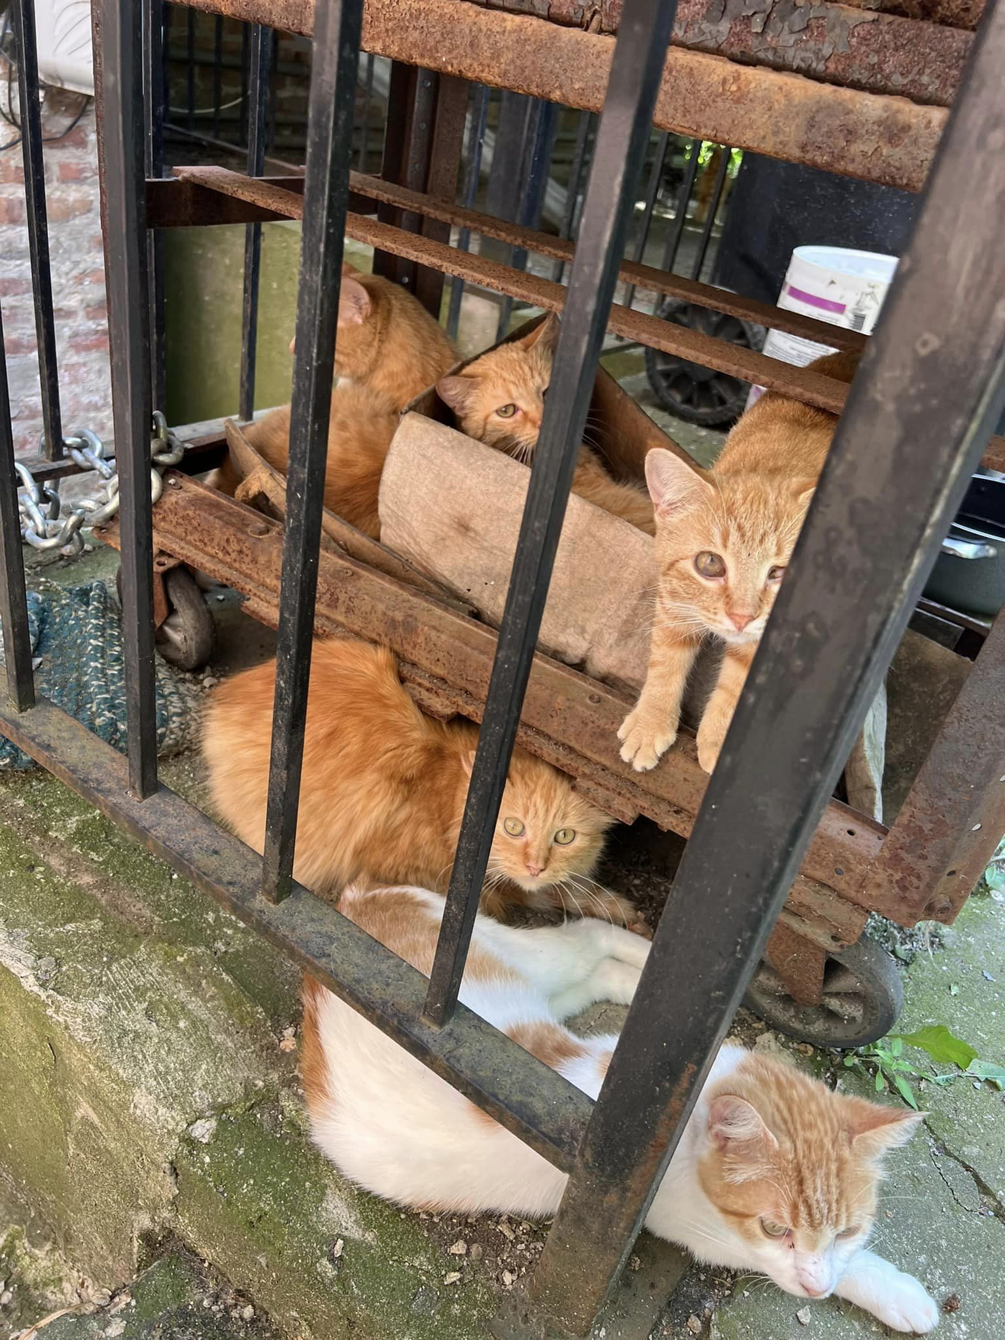
Traditional policies are not working for cats – what’s harder to measure. . .
How many pet cats are abandoned outside when people can’t find placement?
How many sick/injured outside cats can’t get help?
What is happening to cats that don’t get into shelters?
What is happening to feral cats that aren’t getting TNR’d?
How many kittens are dying?
How efficiently are we spending limited resources?
It’s ugly out there!

Slide 6
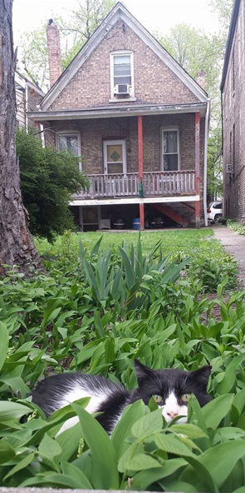
What is an acceptable home for a cat?
What is “home” from a cat’s perspective?
What is an appropriate living situation for a feral vs. friendly cat?
How do we make good decisions for the situations at hand, taking into account the big picture
Longstanding animal welfare policies and practices are closing doors on lifesaving opportunities

Slide 7
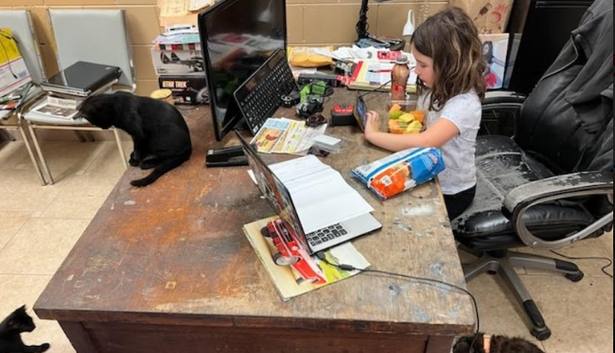
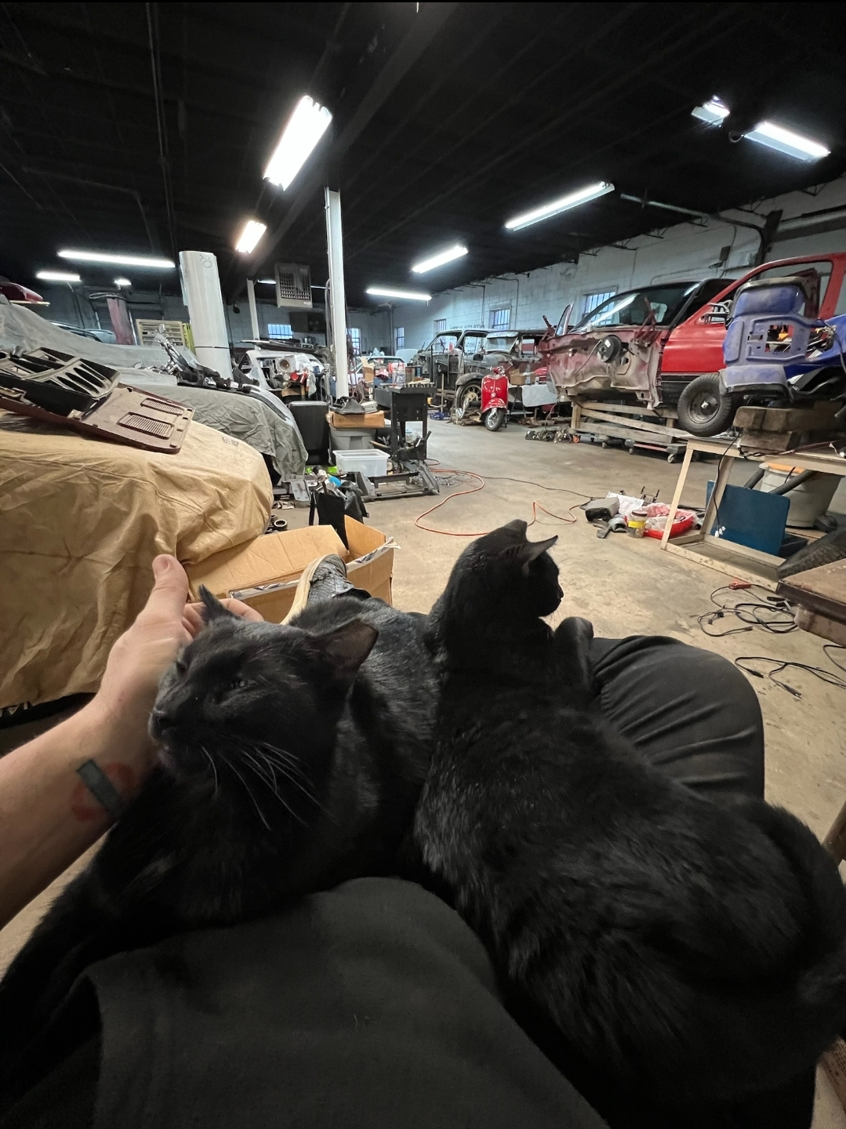
Myth #1
Friendly cats need to be in a proper indoor “house”

Slide 8
Myth #1
Friendly cats need to be in a proper indoor “house”
Employees and customers love them
Shadow and Moonlight live in a custom car garage

Slide 9
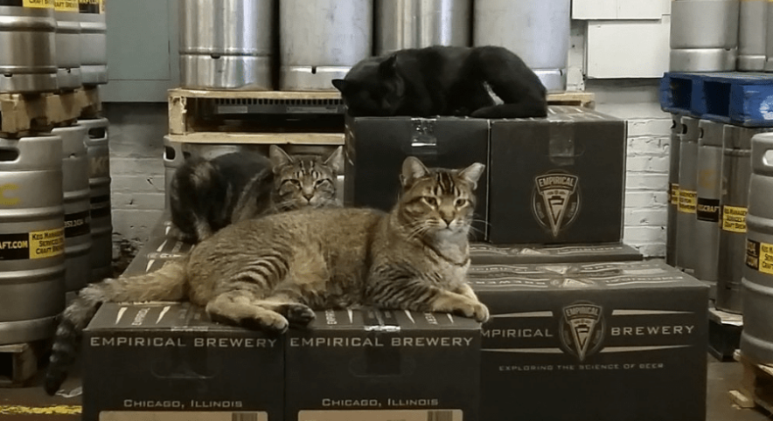
Myth #1
Friendly cats need to be in a proper indoor “house”

Slide 10
Myth #1
Friendly cats need to be in a proper indoor “house”
Venkman, Egon & Ray lived at a craft brewery in Chicago for years

Slide 11
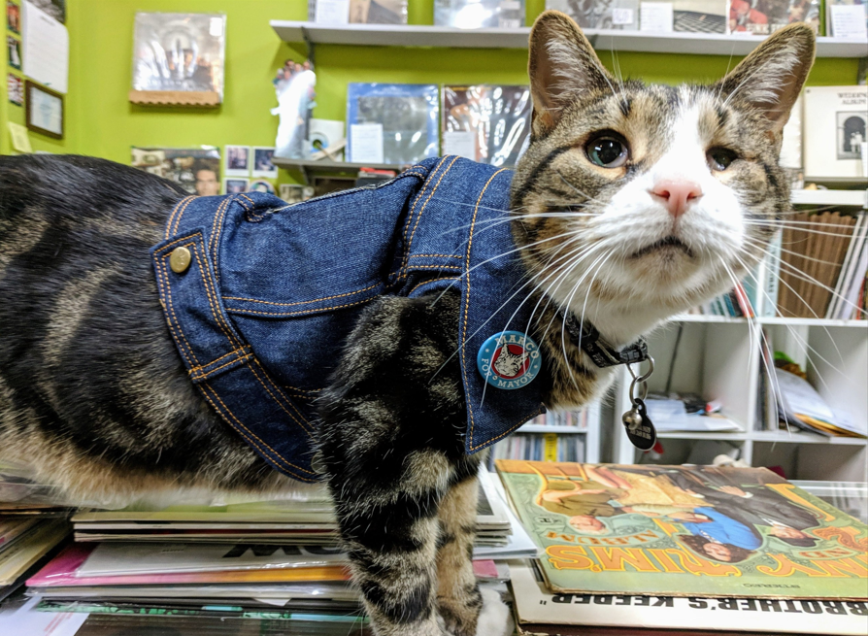
Myth #1
Friendly cats need to be in a proper indoor “house”

Slide 12

Myth #1
Friendly cats need to be in a proper indoor “house”
Marco lives at a record store. He is a fashion icon and music critic
He has run for both Mayor and President

Slide 13
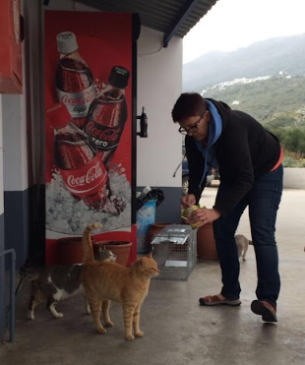
Myth #2
Friendly cats should never be outside

Slide 14
Myth #2
Friendly cats should never be outside
Cat family at a gas station on the Greek island of Amorgos
Outside of the US, outdoor friendly cats are an accepted part of the community
Talk to caretakers & neighbors, gather intel about the cat.
Don’t take away shelter spots with cats who already have a home
Focusing on TNR and returning all healthy friendlies has the largest impact on reducing the population of free-roaming cats

Slide 15
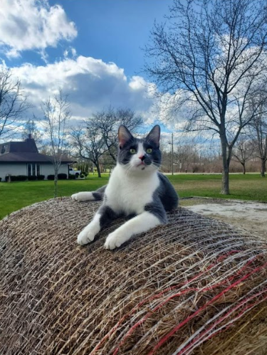
Myth #3
Feral cats that have lived inside can’t be placed outside

Slide 16
Myth #3
Feral cats that have lived inside can’t be placed outside
There are far more cats in need (e.g., hoarding situations) than there are indoor placements like warehouses and breweries
Under-socialized indoor-only cats thrive in the right placement
Hobby farms and horse barns are ideal

Slide 17
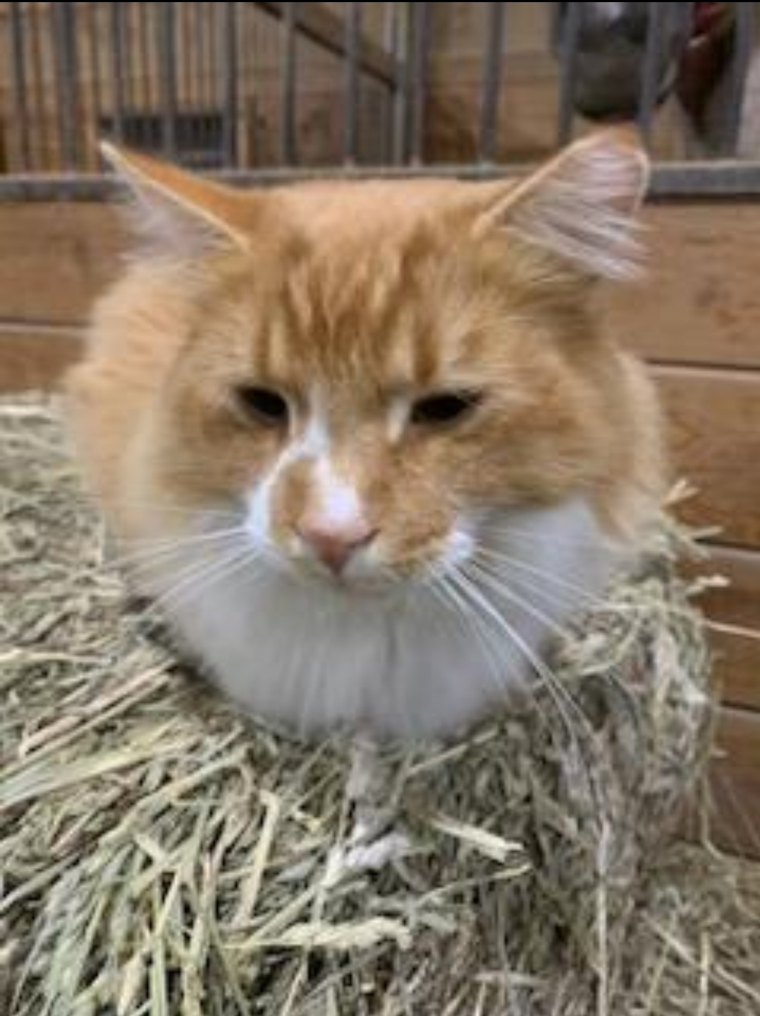
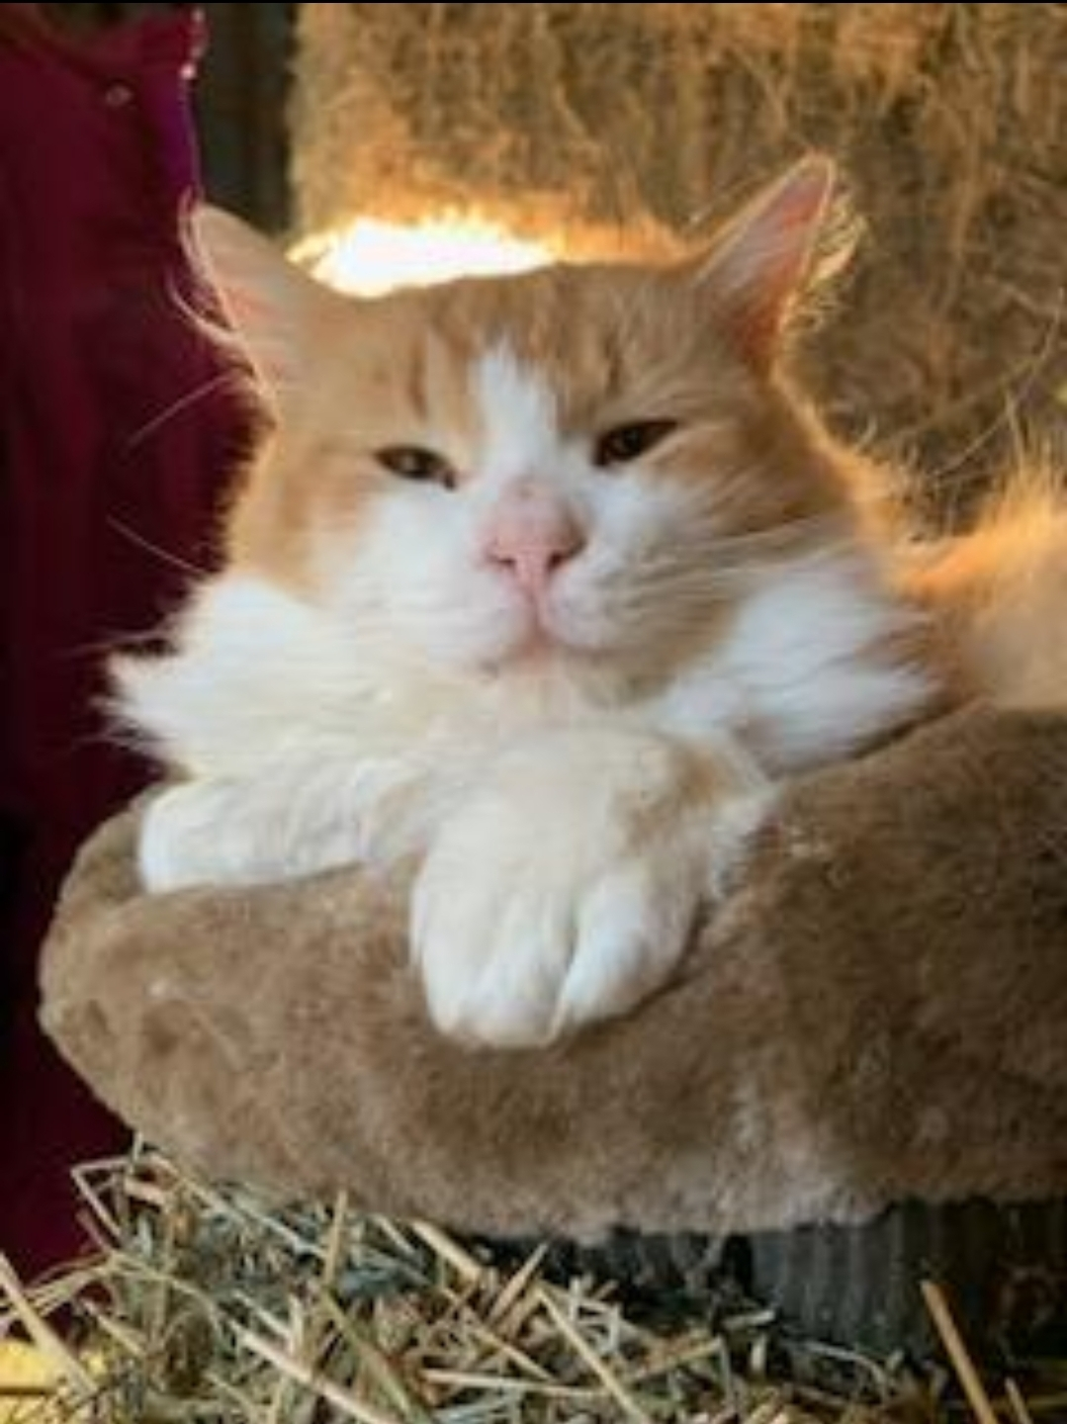
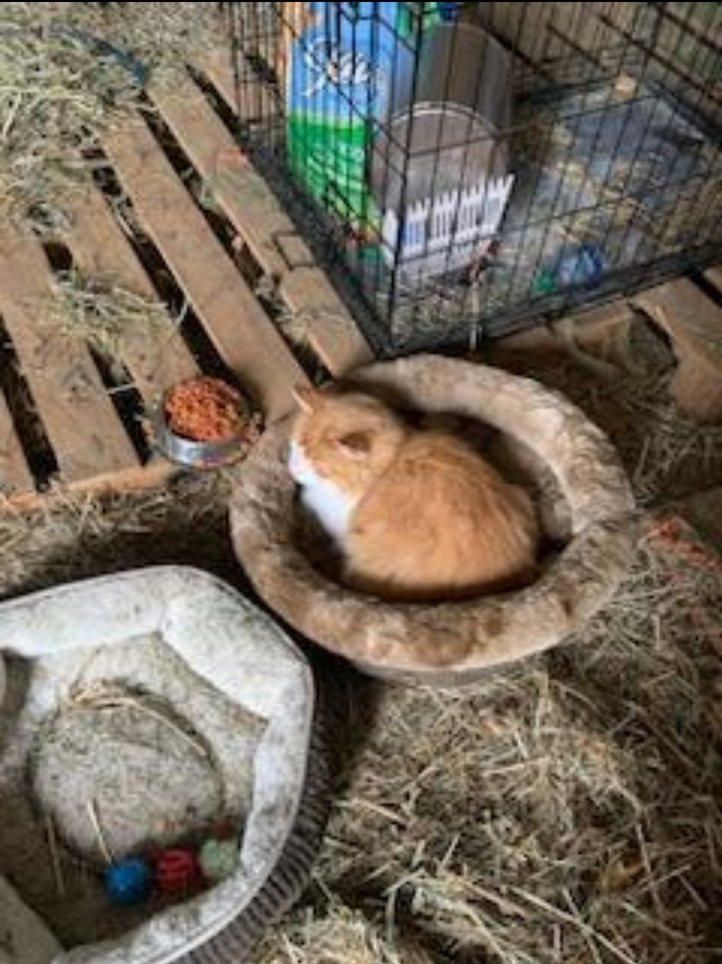
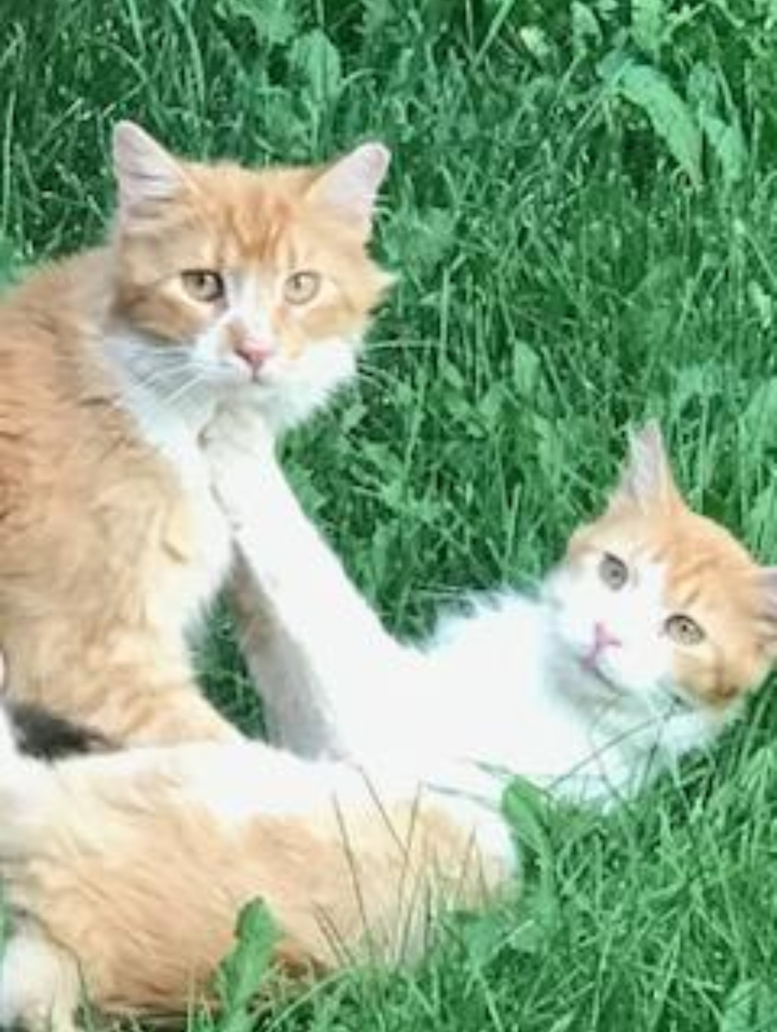
Myth #3
Feral cats that have lived inside can’t be placed outside

Slide 18
Myth #3
Feral cats that have lived inside can’t be placed outside
Bogey & Bacall should have been TNR’d; they were removed from a colony at 4 mo. and never socialized
They spent a year and a half living under a bed!
They went from being terrified and miserable to loving life at a horse barn

Slide 19
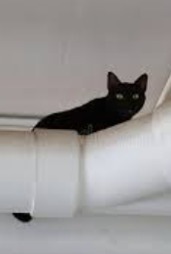
Myth #3
Feral cats that have lived inside can’t be placed outside

Slide 20
Myth #3
Feral cats that have lived inside can’t be placed outside
Older feral kittens that didn’t socialize
Adult ferals lured into a basement for winter
Feral cats brought into a shelter that sat in a care for 2 months
If considerable time has passed, re-acclimate cats using crates

Slide 21
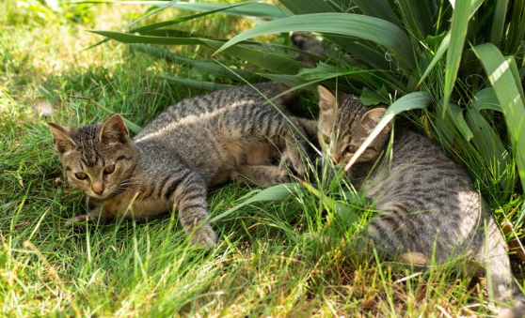
Myth #4
You shouldn’t return kittens

Slide 22
Myth #4
You shouldn’t return kittens
Feral kittens over 12 weeks old are nearly impossible to socialize
Feral kittens 8-12 weeks old can take a long time to socialize
We can fill all foster homes with younger kittens who socialize quickly and get more kittens off the streets
Don’t burn out fosters
Managing kittens detracts from TNR, which has a greater impact on reducing the population

Slide 23
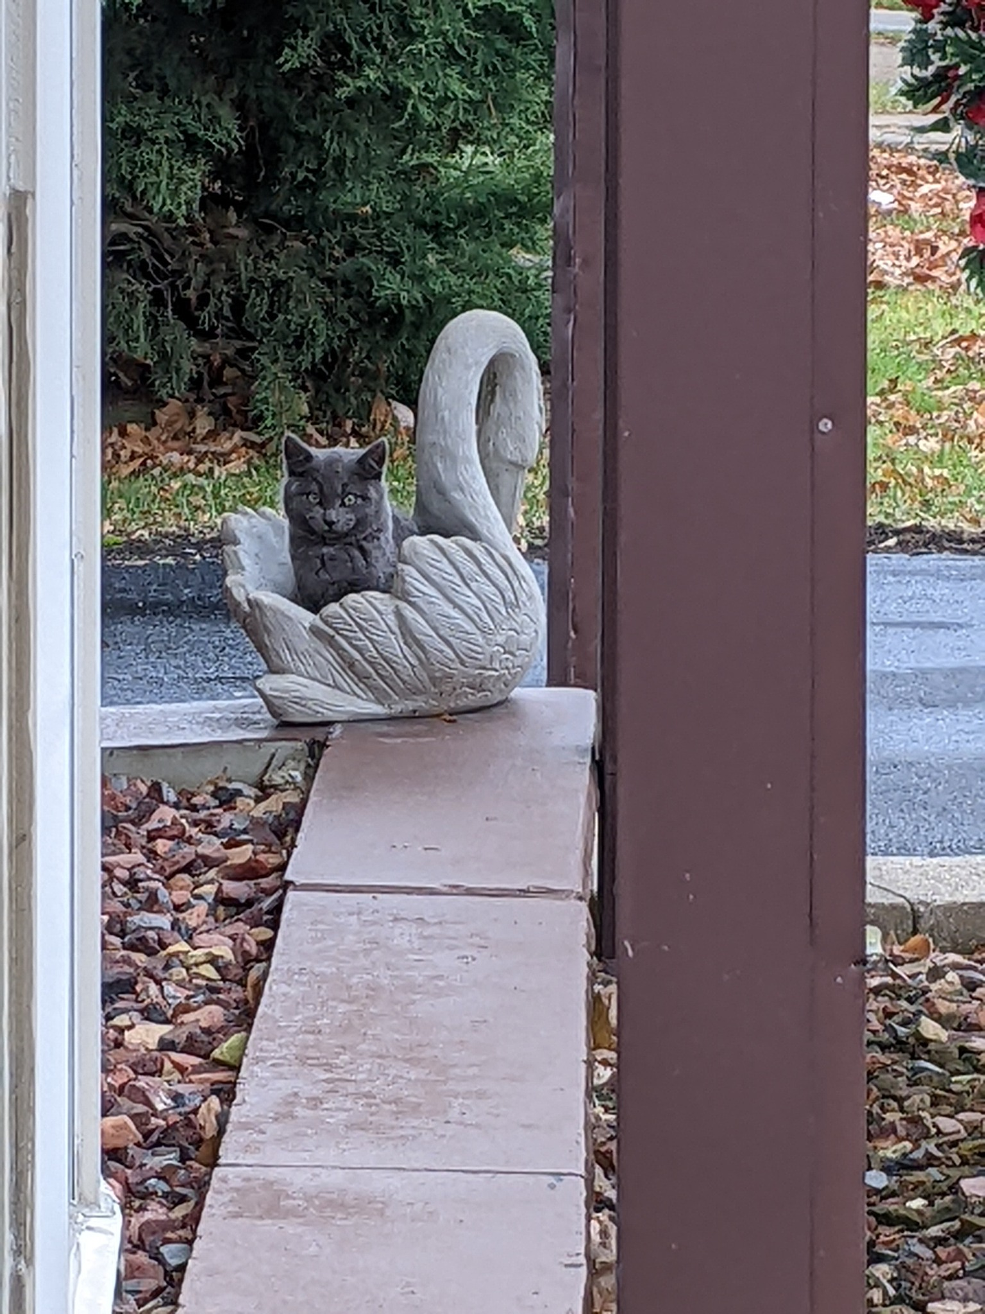
Myth #5
Cats with FIV or FeLV can’t go back outside

Slide 24
Myth #5
Cats with FIV or FeLV can’t go back outside
Do not test cats going back outside
Spend all money on TNR
Sterilize cats to prevent mating and fighting—leading causes of disease transmission
If the cat was already tested, return and monitor as normal
Never euthanize an otherwise healthy cat

Slide 25
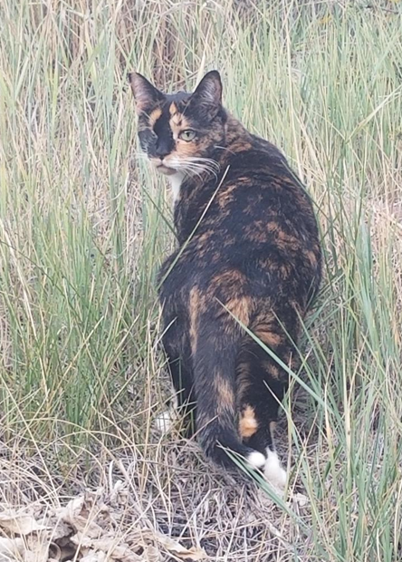
Myth #6
Cats with three legs, one eye,
or no teeth can’t live outside

Slide 26
Myth #6
Cats with three legs, one eye,
or no teeth can’t live outside
Unlikely scenarios not supported by evidence should not guide return decisions
Forcing captivity and human interaction on feral cats is cruel
Most TNR'd free-roaming cats have caretakers; they are not hunting to survive

Slide 27
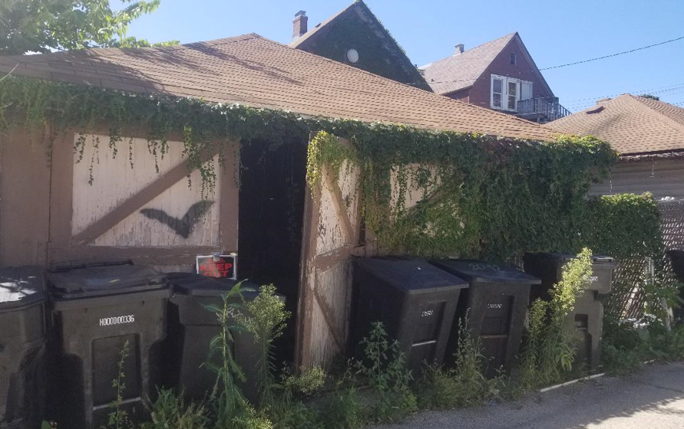
Myth #7
Cats who lost their shelter need to be relocated

Slide 28
Myth #7
Cats who lost their shelter need to be relocated
Cats often have multiple shelter areas and/or will find new ones
When demo crews arrive, cats will safely scatter and return when quiet
Create multiple escape routes
Spend your time talking to neighbors, finding new yards for shelter

Slide 29
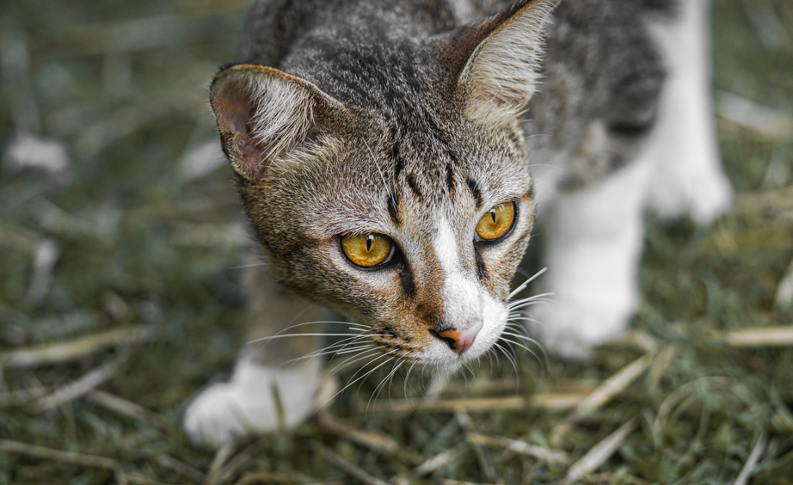
Myth #8
Cats need to be “taught” how to hunt by their mothers when they are kittens or they won’t make desirable barn cats

Slide 30
Myth #8
Cats need to be “taught” how to hunt by their mothers when they are kittens or they won’t make desirable barn cats
Hunting is instinctive
Pheromones deter rodents
Don't hesitate placing "inexperienced" cats in barns
Don’t force under-socialized cats to live inside where they are bored and stressed

Slide 31
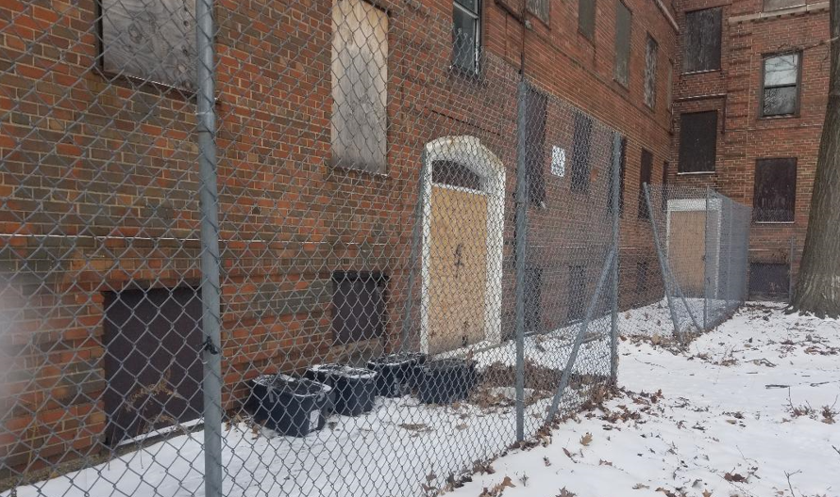
Myth #9
The neighborhood is “too dangerous” for cats

Slide 32
Myth #9
The neighborhood is “too dangerous” for cats
Cats don't track crime statistics
Think like the cat: This is the only home they know
There are cat lovers in every neighborhood
This is a vacant housing project in Chicago

Slide 33
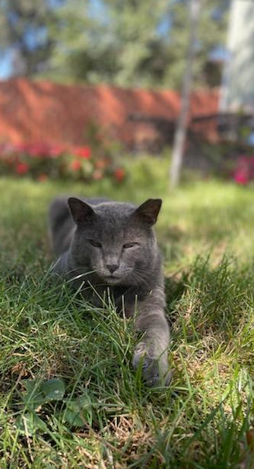
Myth #10
You have to know who is feeding to return a cat

Slide 34
Myth #10
You have to know who is feeding to return a cat
Cats typically have multiple food sources
14% of U.S. households (26% of cat-owning households) provide care—mostly food and water—for free-roaming cats*
They know where the food is, so you don't have to
Sampson had 3 houses in a row feeding him and they didn't know about each other!
* Source: American Pet Products Association’s 2019–2020 National Pet Owners Survey

Slide 35
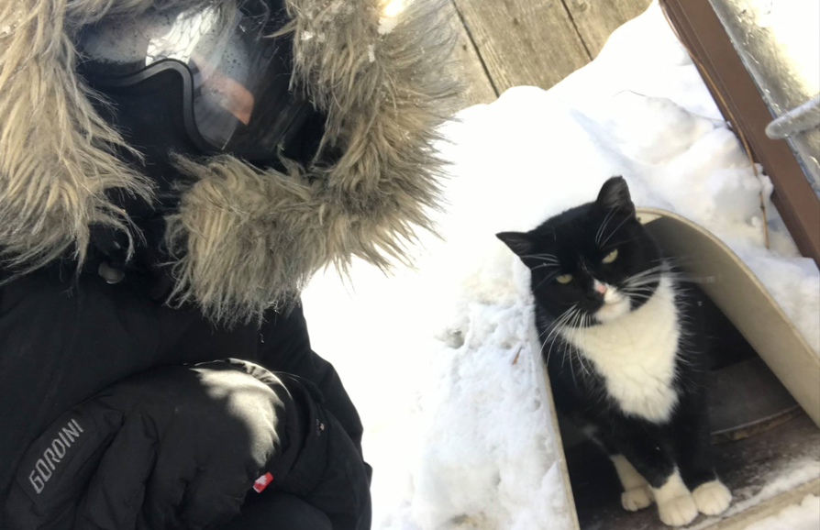
Myth #11
You shouldn't TNR in winter

Slide 36
Myth #11
You shouldn't TNR in winter
Nellie & Janus in Chicago Jan 2019
Mating season begins 3rd week Jan
Delaying TNR only results in more kittens
Cats will not succumb to hypothermia from a small patch of shaved fur
Fur takes months to grow back anyway
Don’t hold cats for days on end following surgery
Provide outdoor shelters with straw

Slide 37

Myth #12
The public doesn’t support friendly
cats living in non-traditional environments; therefore, we risk losing donors

Slide 38



Myth #12
The public doesn’t support friendly
cats living in non-traditional environments; therefore, we risk losing donors
Cat lives on a bike!
And various tents, Airbnbs and vans
Don’t let a handful of ”keyboard cowboys” and “rescue warriors” guide your policy decisions

Slide 39

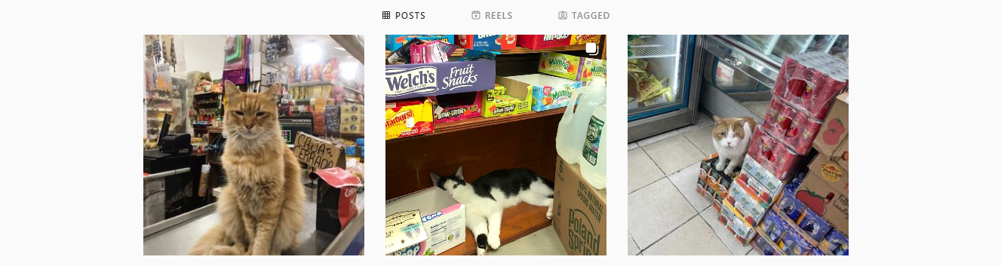
Myth #12
The public doesn’t support friendly cats living in non-traditional environments; therefore, we risk losing donors

Slide 40
Myth #12
The public doesn’t support friendly cats living in non-traditional environments; therefore, we risk losing donors
Who doesn’t love bodega cats?
Half a million devoted followers
Features shop cats from around the world

Slide 41
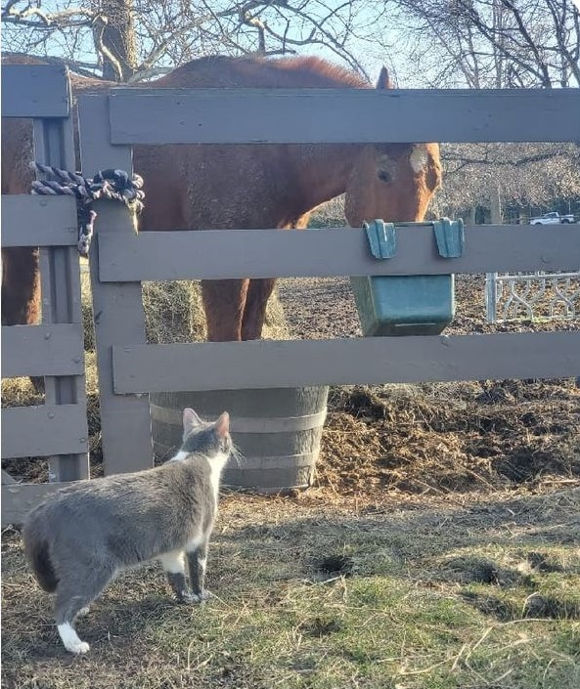
Conclusions
Don’t get sidetracked doing “everything” for every cat – think of all of the other cats out there (e.g., Keep the big picture in mind)
Use your limited time and resources effectively and efficiently
Put yourselves in the cat’s paws; don’t project human emotions and ideals on cats
Open your minds to non-traditional homes so you can save more cats
Don’t let “Keyboard Cowboys” and “Rescue Warriors” deter you from making good decisions for cats
Celebrate (and publicize!) your successes
Ultimately, it’s our responsibility to share knowledge, experience and best practice

Slide 42
Thank You!
Erica Roewade
Outreach Director
Liz Houtz
Programs Director
www.catsinaction.org
info@catsinaction.org

